Slide 1
Getting Started Developing .NET Cloud Applications on Azure Using Visual Studio
Mikkel Mork Hegnhoj, Program Manager
mikhegn@microsoft.com
@mikkelhegn

Slide 2
Introduction
Visual Studio and Azure
Getting Started – Visual Studio, .NET and Azure
Diagnostics and Debugging in the Cloud
Containers and Microservices

Slide 3
Visual Studio – Azure Developer Experience
Fundamentals for how we help developers be successful with Azure
Great local developer experience for .NET
Getting Azure setup for you and publish your application
Integrating your application with Azure services
Configuring continuous integration and delivery
Built-in diagnostics to help you understand how your code runs in Azure

Slide 4
Getting Started
Dev Tools
Azure Development Workload in Visual Studio
”Infrastructure” / Resources
Azure Resource Manager and ARM Templates
Deployment
Continuous Delivery and Integration using Visual Studio Team Services
Insights
Azure Monitor, Application Insights and OMS

Slide 5
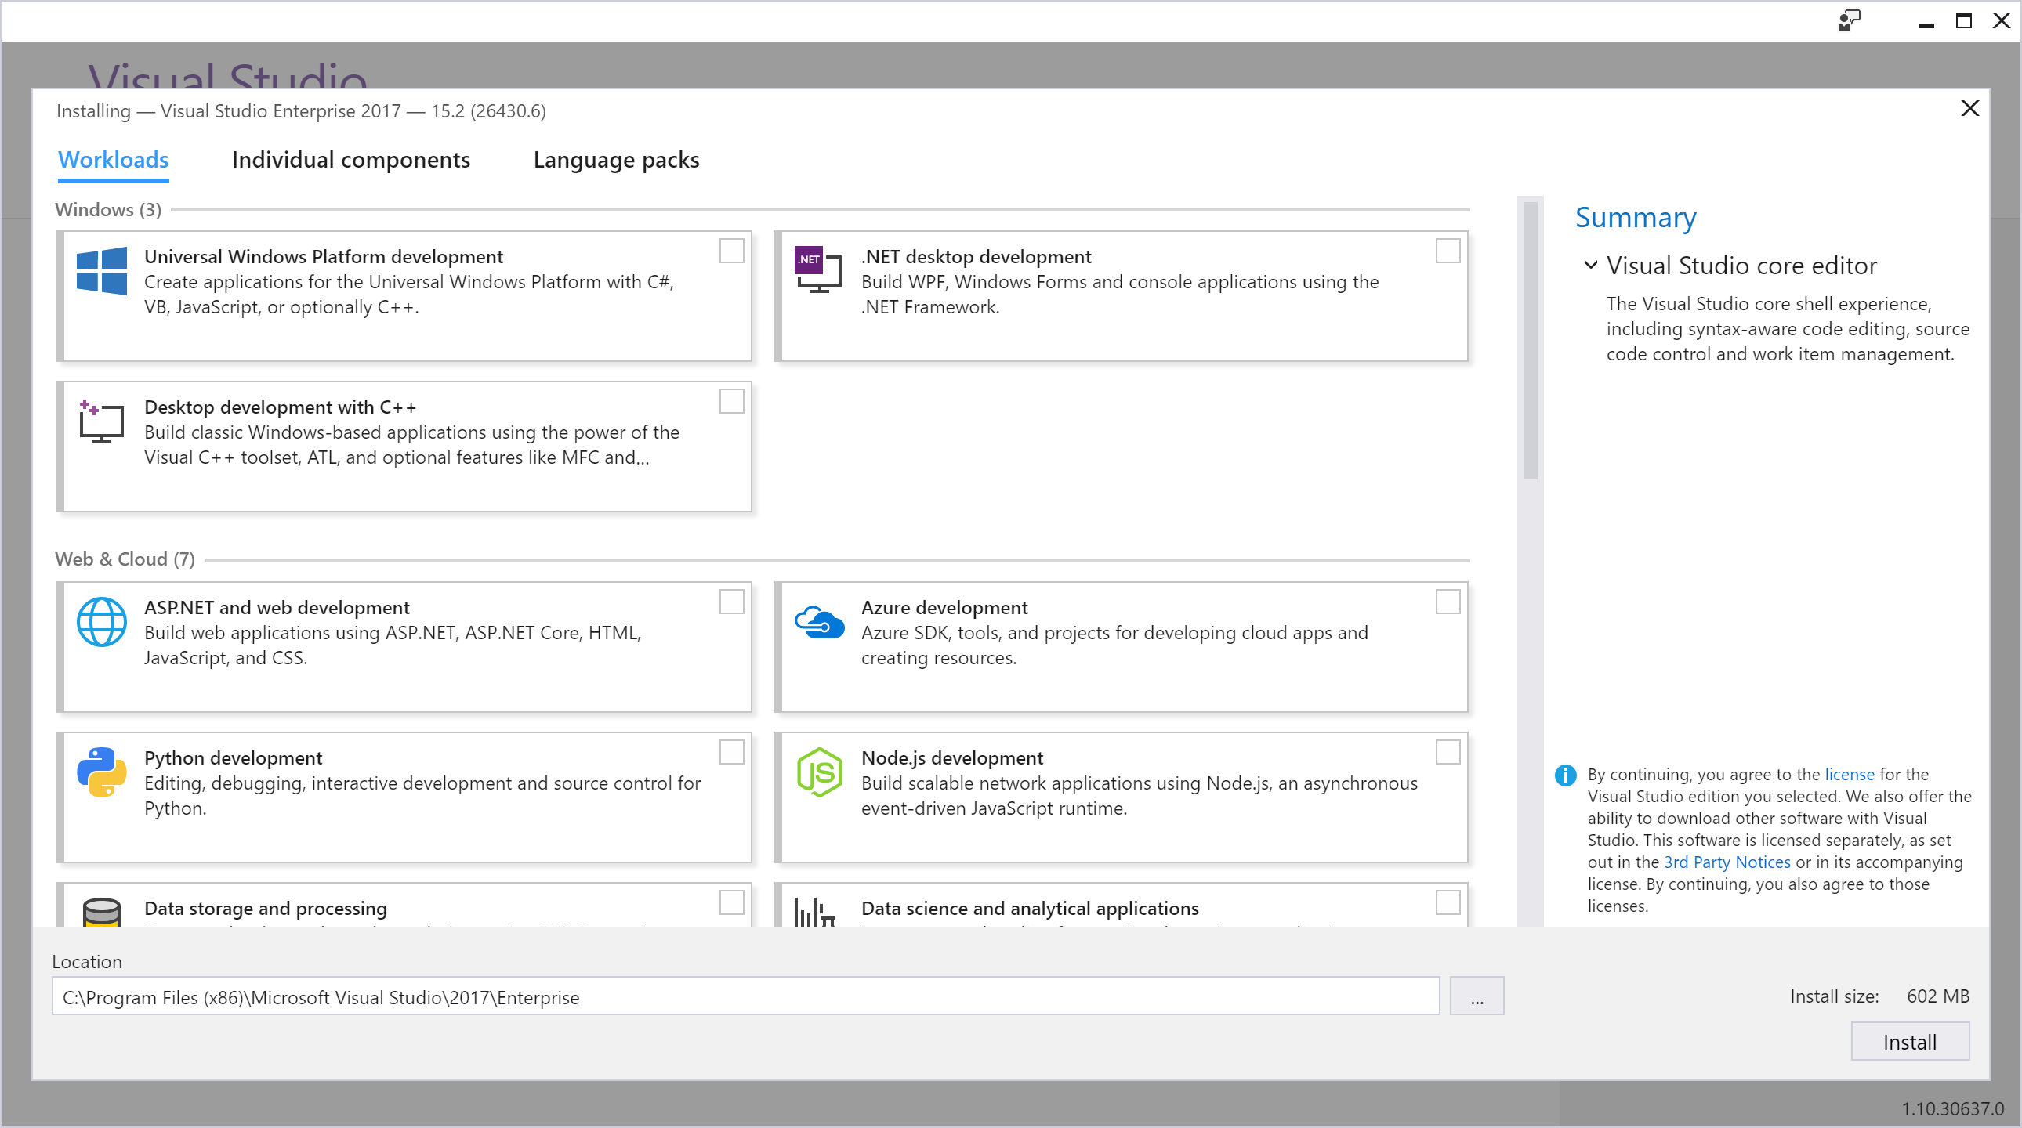
Visual Studio Installer

Slide 6
Azure Resource Manager
Azure Resource Manager
Declarative Solution for Deployment and Configuration
Consistent Management Layer
Visual Studio and VS Code tooling
Azure Resource Groups
Tightly coupled containers of multiple resources of similar or different types
Resource Group is a unit of management (RBAC)
Deployment, Update, Delete
Identity
Metering, billing, quota
RESOURCE GROUP

Slide 7
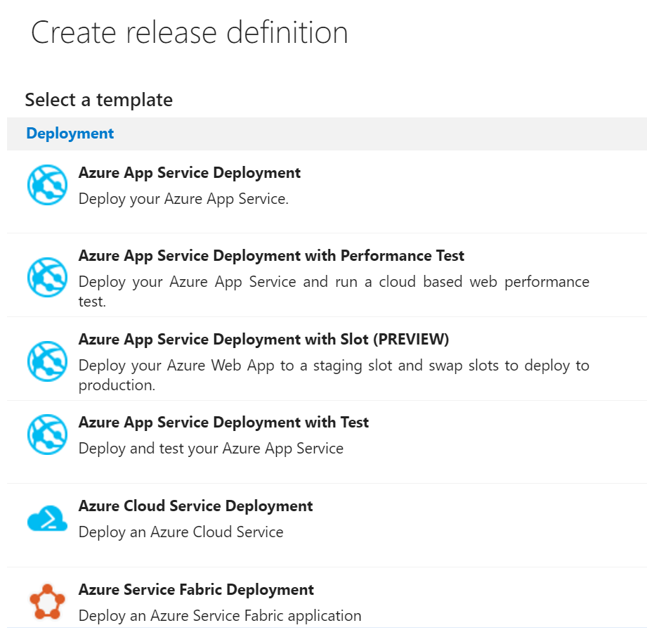
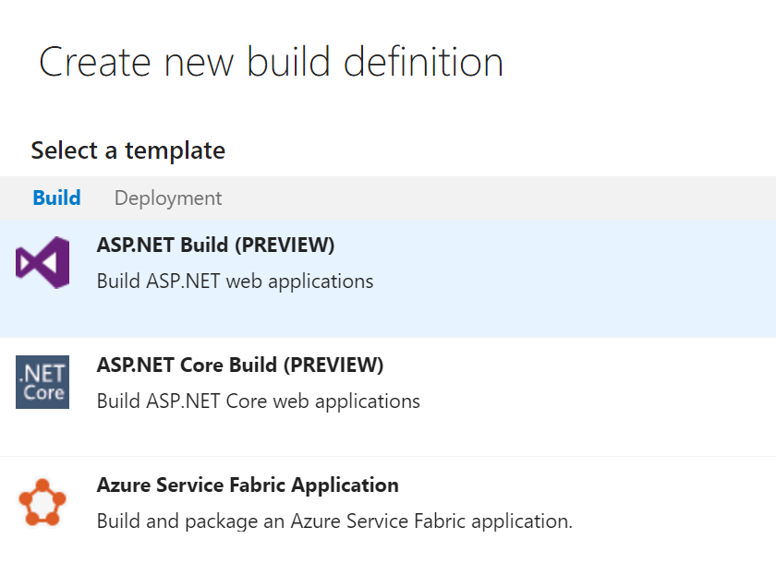
CI/CD Pipelines
Deployment
ARM / REST / PowerShell / X-Plat CLI / Service Specific
Visual Studio Team Services
Predefined build and release definitions
Workload Tests

Slide 8
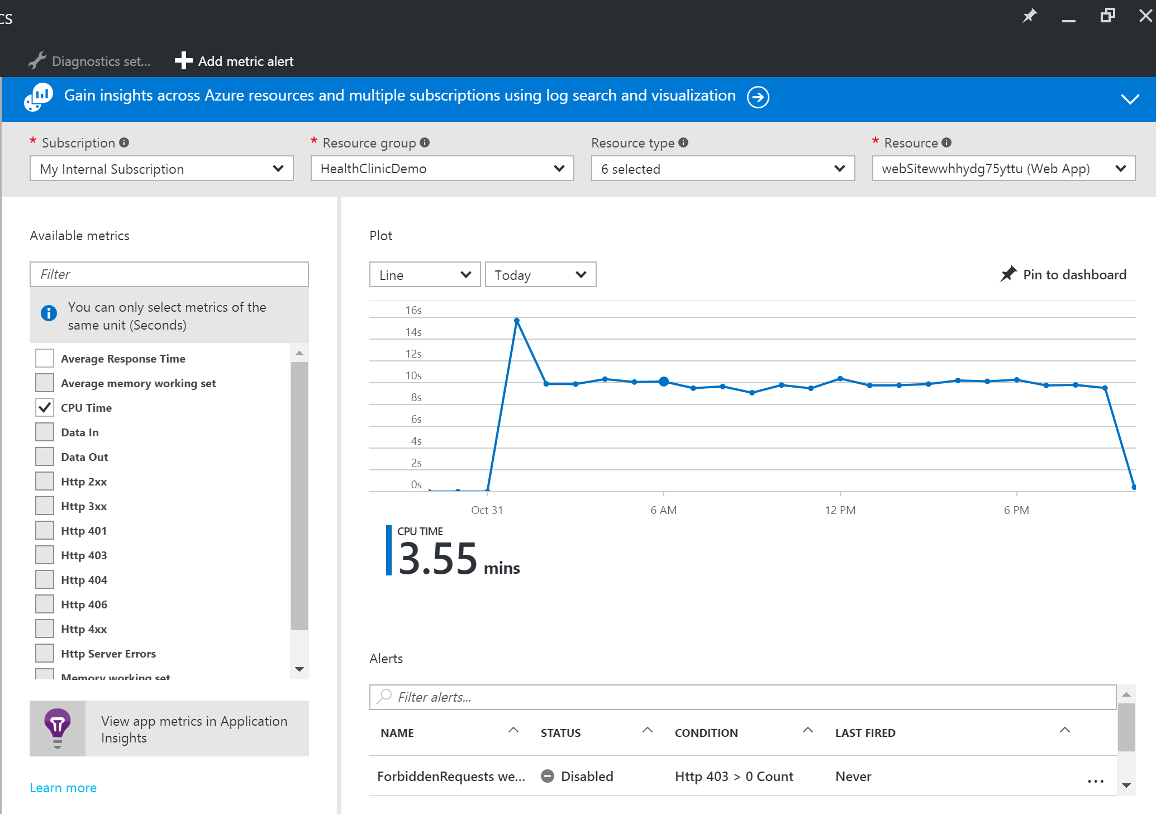
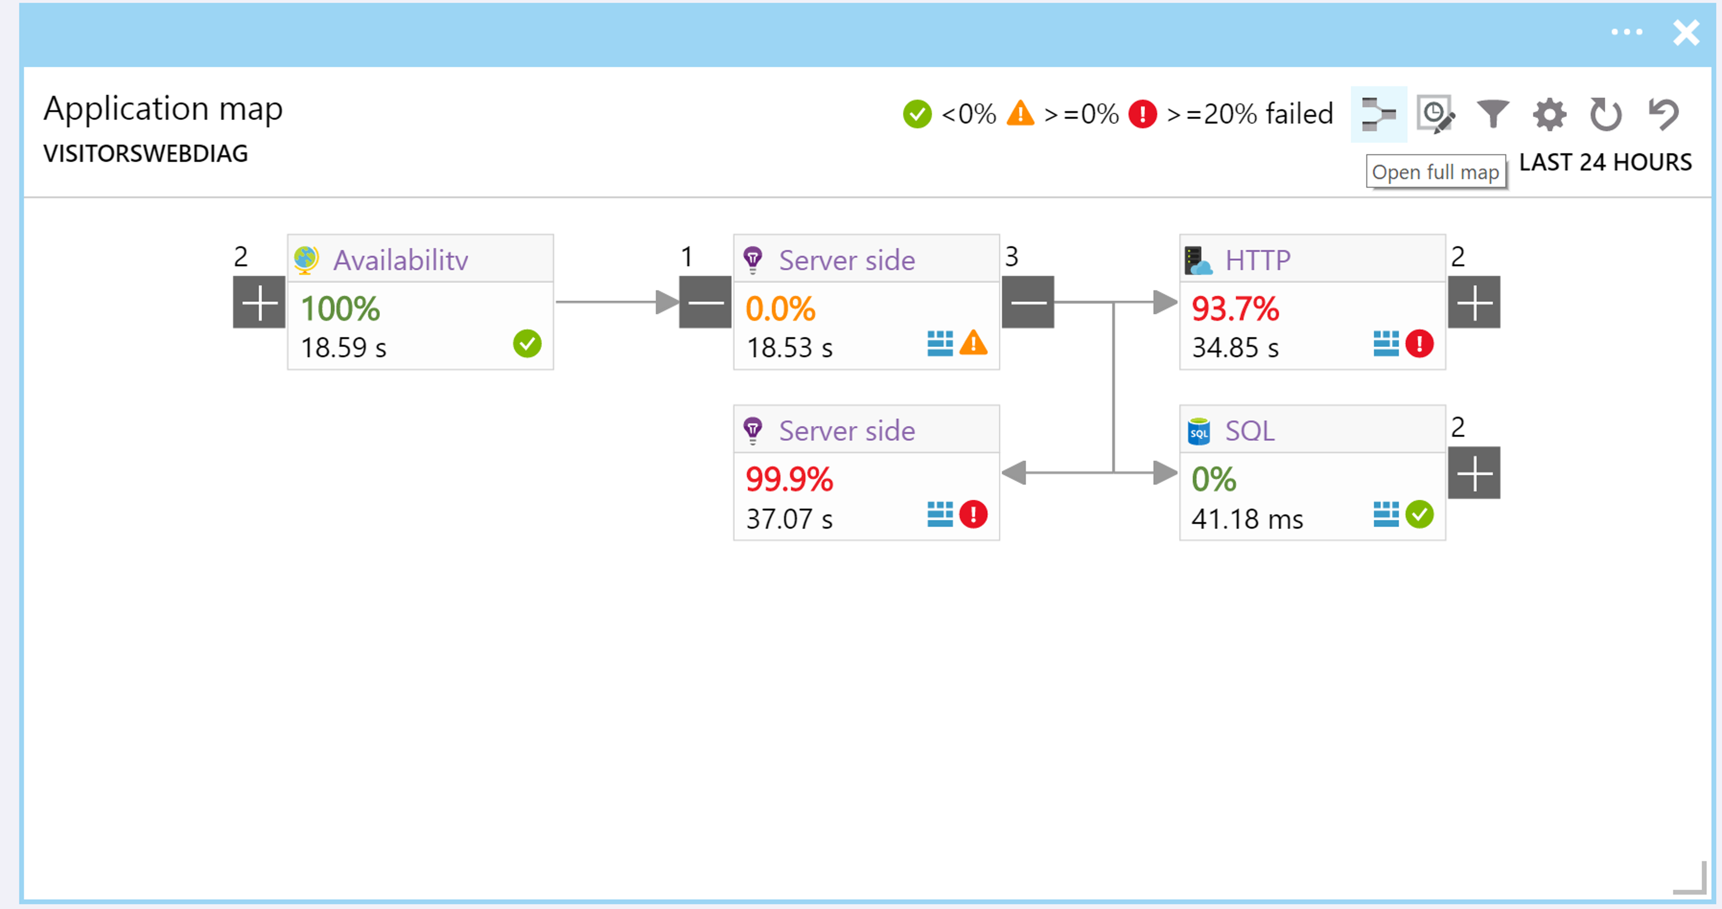
Insights
Your application
Application Insights
Your resources
Azure Monitor and OMS

Slide 9
Visual Studio to Azure in 5 minutes
DEMO

Slide 10
Diagnostics and Debugging in Azure
Application Map – Automatic Correlation
SnapShot Debugger for Azure
Application Insights Profiler

Slide 11
Diagnostics and Insights
DEMO

Slide 12
Containers and Microservices
What’s the deal?
Azure as the Platform for Microservices
Modernizing .NET 4 applications with Containers

Slide 13



Why Microservices?
Continually evolving applications
Faster delivery of features and capabilities to respond to customer expectations
Build and operate a service at scale
1
4
Monitor + Learn
Plan
Development
Production
2
3
Release
Develop + Test

Slide 14
Why Containers?
Immutable images of your application and all dependencies
Works on my machine = Works everywhere
Eliminate problems with conflicting dependencies on hosts
Units that are easy to deploy and orchestrate
A great deployment vehicle for microservices

Slide 15
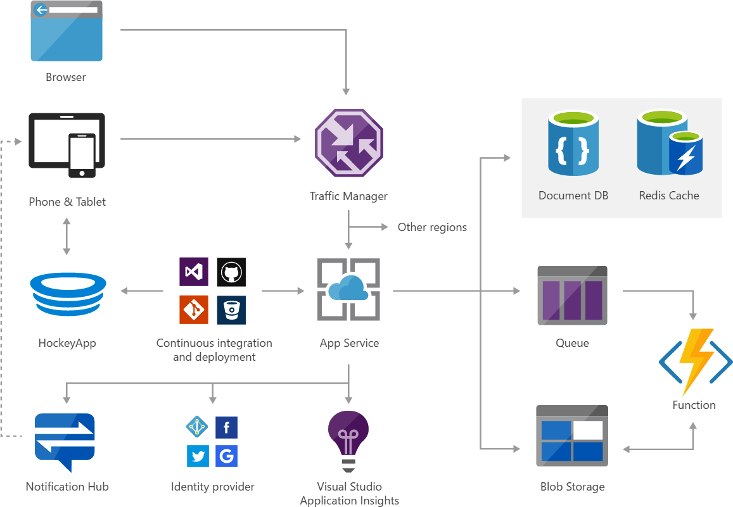
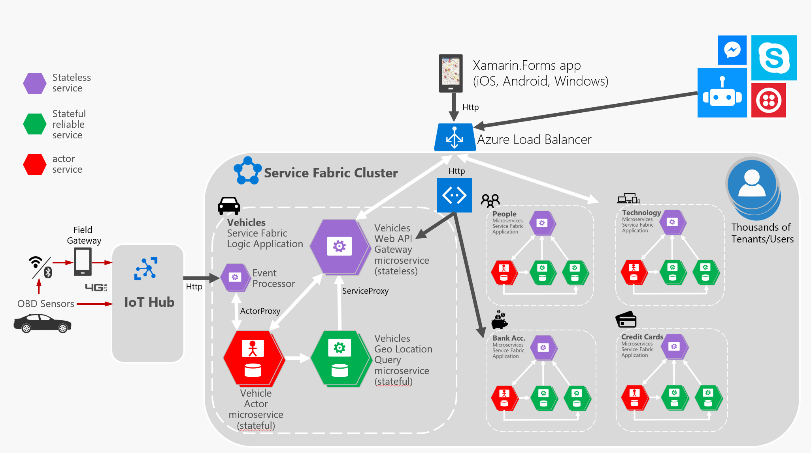
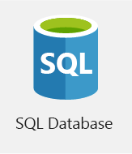
Microservices in Your Application
1. Simple complementary microservices
2. Complex microservices architectures

Slide 16

Azure as the Platform for Microservices
Azure as the Platform for Microservices
Azure Functions
Azure Service Fabric
Azure Container Service
Serverless, event driven functions
Microservices and Container Orchestrator – Stateful & Stateless services
Container Orchestrators
Mesos DC/OS,
Docker Swarm
Serverless Compute
and simple Microservices
Microservices and Containers
(“Windows-mature”
& Application Model)
Microservices and Containers
(“Linux-mature”)

Slide 17
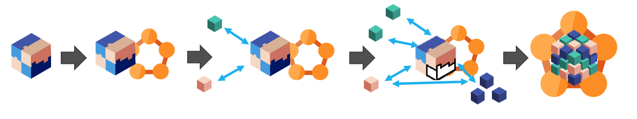
Containers for .NET 4 Applications
Modernization
Consolidation of workloads
High reliable / high density platforms
Modern Cloud DevOps

Slide 18
.NET app in a container to Azure Service Fabric
DEMO

Slide 19
Resources
Azure Tools - http://aka.ms/azuretools
Continuous Delivery - http://aka.ms/cd4vs
Azure Diagnostics - http://aka.ms/azurediagnostics
ASP.NET 4 Containers - http://aka.ms/aspnet4containers
Azure Developer Guide - http://aka.ms/adg
Azure Solutions - http://azure.com/solutions
mikhegn@microsoft.com / @mikkelhegn

Slide 20
Questions?
Please use Events XD (EventBoard) to fill out a session evaluation.
Thank you!

